Slide 1
Training for Taught Postgraduate Course Representatives
name of trainer
associate trainer | sparqs

Slide 2
sparqs
student partnerships in quality scotland.
Our role is to ensure that students can make a positive difference to learning and teaching.
Around 4000 reps trained each academic year.
Funded by the Scottish Funding Council since 2003.

Slide 3
Learning outcomes
Understand course representation at PGT level and the work involved in being a PGT course rep.
Describe the importance of partnership between staff and students in shaping the PGT learning experience.
Explain the PGT Student Learning Experience and how you can use it to assist you in your work as a course rep.
Reflect on the skills you will use as course rep.
Notes:
3

Slide 4
What we’ll be covering
Communication with staff.
Communication with students.
The PGT Student Learning Experience.
Scenarios you might face.
Meetings.
Notes:
4

Slide 5
Communication with staff

Slide 6
The nature of PGT study
High levels of part-time study.
Often small cohorts.
Heavy professional focus, with your workplace or work placements.
Heavy research focus, for dissertations or projects.
Contact with staff can be frequent and informal.
What are the opportunities & challenges in here?
Notes:
6
It’s worth stressing that this information may vary from institution to institution – there may be relevant local information to hand to discuss here.
But generally speaking, the course committee manages a course, looks at what students think about it, and makes decisions about improving it.

Slide 7
Top tips
See being both a student and being a member of an academic community as an opportunity, not a contradiction.
Stay focused on the learning, not the teaching.
Work in partnership with staff – expectations must be realistic (on both sides!).
Remember the ABCD of Effective Feedback…
Notes:
7
It’s worth stressing that this information may vary from institution to institution – there may be relevant local information to hand to discuss here.
But generally speaking, the course committee manages a course, looks at what students think about it, and makes decisions about improving it.

Slide 8
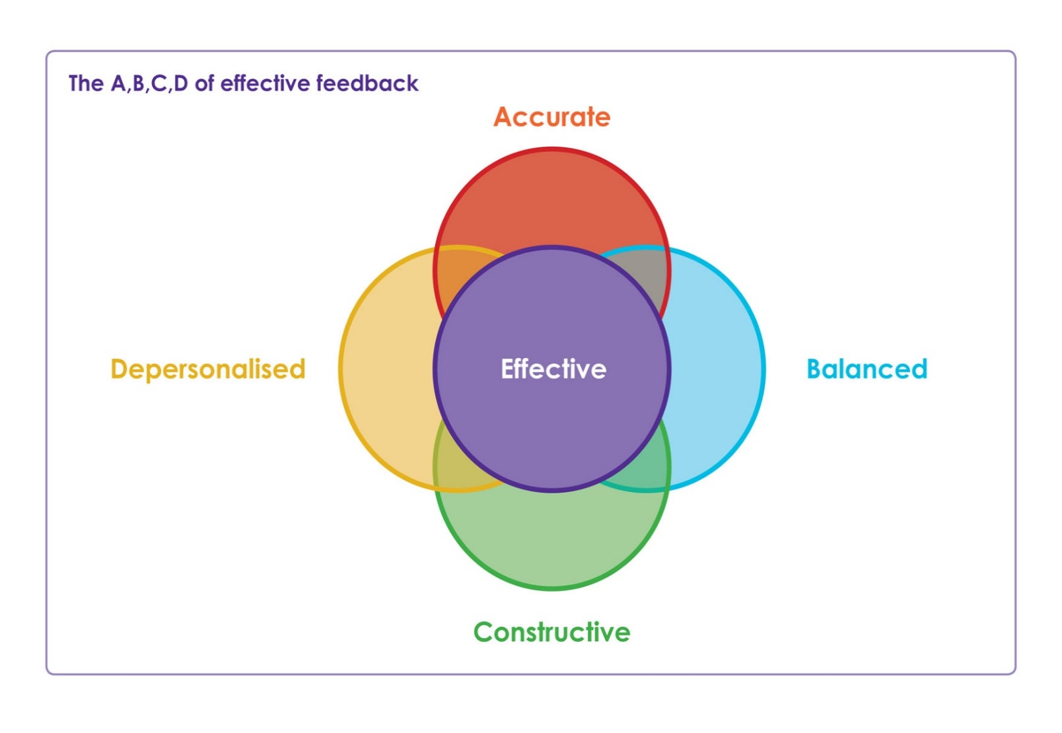
The ABCD of Effective Feedback

Slide 9
Communication with students

Slide 10
Course rep
Students on your course
Students’ association
Other course reps

Slide 11
Students on your course
In-class conversations.
The Virtual Learning Environment (VLE).
Social media forums.
Email groups.
Notes:
Generate discussion about access to information (eg emails – you can seek advice on data protection from the SA, but you’re generally best off using university email addresses).
Or social media forums – what are the risks or opportunities in doing this? How might staff perceive this?

Slide 12
Other course reps
Rep meetings – at subject area or university level, often including undergraduates.
Informally.
Before and after course meetings.
Notes:
Generate discussion about access to information (eg emails – you can seek advice on data protection from the SA, but you’re generally best off using university email addresses).
Or social media forums – what are the risks or opportunities in doing this? How might staff perceive this?

Slide 13
The students’ association
Represents all students!
Has key role in contributing to the nature of learning and teaching.
Depends heavily on hearing about reps’ experiences to shape its work.
How can you learn from and contribute to the SA?
Notes:
Generate discussion about access to information (eg emails – you can seek advice on data protection from the SA, but you’re generally best off using university email addresses).
Or social media forums – what are the risks or opportunities in doing this? How might staff perceive this?

Slide 14
Closing the loop
Don’t forget to
Feed back
what you have achieved!!
Feedback
Identify
the issue
Develop &
implement
the solution

Slide 15
The Postgraduate Taught
Student Learning Experience

Slide 16
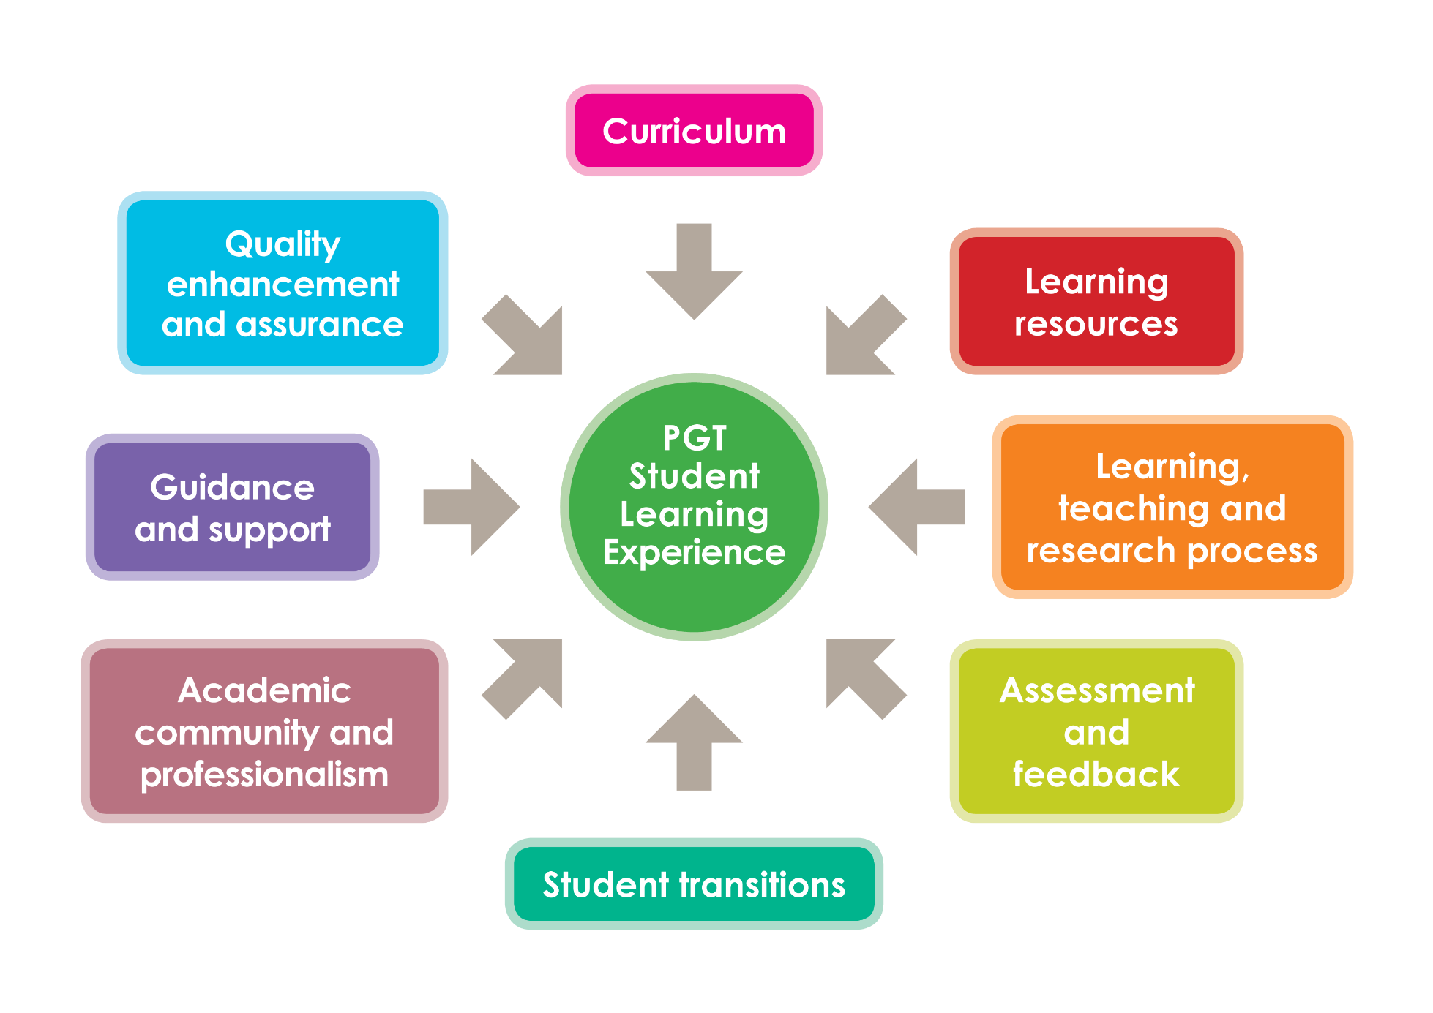
Notes:
16

Slide 17
Scenarios

Slide 18
What would you do?
Have a look at the scenarios on p12 of the handbook.
Discuss in groups what you as a course rep are able to do.

Slide 19
Meetings

Slide 20
Before, during, after
Before:
Understand remit and composition.
Research views, identify ideas and suggestions.
Liaise with other reps.
During:
Engage in a professional manner. Use the ABCD again!
Support other reps.
Agree outcomes and actions.
After:
Feed back to fellow students and the SA.
Follow up on action points.

Slide 21
Next steps

Slide 22
Next steps
Action points.
Further support available:
Students’ association
Teaching staff
Each other!
sparqs – www.sparqs.ac.uk
Reflect on skills within broader professional development.

Slide 23
Learning outcomes
Understand course representation at PGT level and the work involved in being a PGT course rep.
Be able to describe the importance of partnership between staff and students in shaping the learning experience.
Discuss the PGT Student Learning Experience and explore how you can use it to assist you in your work as a course rep.
Reflect on the skills you will use as course rep.
Notes:
23

Slide 24
Please complete and return your evaluation form!

Slide 25
Training for Taught Postgraduate Course Representatives
name of trainer
associate trainer | sparqs

